Slide 1
The National Center for Innovation
JORDAN
INVENT- Promotion of Innovation Culture in the Higher Education in Jordan
Final Conference
September 25, 2018
Fawwaz Elkarmi
Assistant Secretary General
Higher Council for Science and Technology
How will the NCI get there

Slide 2
Challenges in Jordan’s Innovation Landscape
1) Innovation is poorly defined and measured.
Innovation promotion is misidentified as enterprise support, leading to misallocation of public resources away from actual innovation, and innovation metrics that are either not collected or are of questionable relevance.
2) Innovation strategy and information are poorly coordinated.
Innovation stakeholders do not respond to national development priorities and innovation information systems (to the extent that they exist) are not interoperable with their international peers.
3) Commercialization opportunities are missed.
There is a broad failure to identify, track, and encourage commercialization of research, to affect knowledge transfer across institutional or sectorial boundaries, and to engage with multinational and global centers of research excellence.
4) The innovation value chain has key gaps
Policy, funding, and incubation spaces are crowded but misaligned to innovation needs. Knowledge transfer and information management are underserved.

Slide 3
Challenges in Jordan’s Innovation Governance
1) The Higher Council for Science and Technology has a strong legal basis…
The HCST is empowered to promote and coordinate innovation by virtue of a robust and forward-thinking founding law…
…but it has not fully realized its potential.
The HCST risks losing its mandate to outside entities that have neither the national scope of vision nor a commitment to national development priorities. The HCST mandate is not clear to stakeholders, with no consensus on what it can and cannot do in the innovation landscape.
2) Antiquated models of coordination prevail.
Innovation coordination is being approached through passive data collection and antiquated regulatory models that require public resources and are labor intensive (issuing surveys, populating databases)

Slide 4
Innovation System
The country’s innovation system—firms, research centers, universities, think tanks, consultants, and other organizations—must be capable of tapping the growing stock of global knowledge and adapting it to local needs, as well as creating new products and processes that can compete in export markets and meet needs at home.
© World Bank 2013

Slide 5
Why Innovate?
Innovation is increasingly acknowledged as important driver of value creation, economic growth and social welfare.
It is estimated that the payoff of promoting research, innovation and adaptation, and enforcement of property rights could add 1 percentage point to GDP growth per year.
An increasing number of countries – at different stages of economic development – take steps towards underpinning their economic development by more innovation.
The country’s innovation system—firms, research centers, universities, think tanks, consultants, and other organizations—must be capable of tapping the growing stock of global knowledge and adapting it to local needs, as well as creating new products and processes that can compete in export markets and meet needs at home.
© World Bank 2013

Slide 6
Needed interventions
Short and medium term interventions should concentrate on the determinants of innovation that have the highest impact:
Business environment
Finance
Skills and marketing
Diversification and reform
© World Bank 2013

Slide 7
Business environment
Policy reforms to increase fare competition.
Facilitate entry and exit and investor rights protection.
Policy for cross boarder and international trade with "good" government support.
© World Bank 2013

Slide 8
Finance
It should include: VC funds, angle investors, seed financing, private equity, public capital markets, debt, and matching grants.
Providing wider access, lower cost and longer payback duration for early stage innovative start-ups and entrepreneurs.
Developing pre-bank financing infrastructure and/or guarantee fund.
© World Bank 2013

Slide 9
Skills and marketing
Improve local linkages (public, private, education, R&D, etc.)
Improve global linkages including enhancing FDI and Diaspora linkages.
Increase human capital capacity by investing in skills training and strengthening capacity of S&T institutions.
Improve business management and marketing skills of innovators and entrepreneurs.
© World Bank 2013

Slide 10
Diversification and reform
Successful clusters.
Include all "would-be" innovators (youth, women, refugees, informal sector, etc.)
Integrate supply chain systems by increasing intra-industry trade.
Expand/deepen reforms in key policy areas: education, innovation, ICT and business environment.
© World Bank 2013

Slide 11
Status of Innovation support in Jordan (1)
Presently Innovation in Jordan is driven by personal and some institutional initiatives,
Most activities, such as applying for a grant fund, are carried out manually with lots of paper work,
Information update regarding research interests and activities is very slow or not happening,
Possibilities of global networking and joint venturing is minimal as it depends on personal relations and previous associations,
Duplication of efforts is wide-spread and some initiatives do not know about other similar or competing initiatives,
Performance indicators or key statistics are not readily available but need time and effort to compile and generate useful information.

Slide 12
Status of Innovation support in Jordan (2)
Access to international scientific journals and publications is costly and only very few universities avail this service to researchers,
Funding is scarce and if available requires a long time and it might not happen after all the efforts exerted,
Research output is only translated, in many cases, into publications (for promotion purposes) and rarely gets into commercialization or even prototyping,
University or research center facilities for start ups and project development is not present in Jordan,
Incubation and support services are not strong to generate new start ups at universities and research centers,
Profit sharing schemes and equity issues for start ups is not yet developed in Jordan.

Slide 13
Status of Innovation support in Jordan (3)
Private sector funding and banks are not convinced of the quality of research results due to lack of information and success stories,
Industries and commercial enterprises do not see the value of research and innovation out of Jordanian universities and research centers,
Many international funding programs are aware of the lack of national coordination and support for innovation and consider this as a negative point.

Slide 14
The Role of the NCI
The National Center for Innovation (NCI) has been proposed as a coordinating hub for Jordanian innovation, collecting information, evaluating innovation performance, and facilitating policy dialogue.
The task at hand:
A mapping study was done to investigate how the NCI could best achieve the improvement of Jordan’s innovation landscape, answering the following:
What international best practices are most useful to Jordan?
How should the NCI intervene in the innovation ecosystem?
What organizational structure will best serve the NCI’s aims?
How can the NCI sustain itself financially?
How should the NCI be activated in the near term?

Slide 15
A Typology of Best Practice Interventions in Innovation
We organized the best practices within six domains in which innovation agencies and stakeholders around the world intervene in their national innovation systems.
These domains can be placed along a value chain from
enabling policy → to knowledge production → to transfer & support services.

Slide 16
Setting a Vision for the NCI
The following roles for the NCI are recommended along Jordan’s innovation value chain:
Innovation Vertical | Recommended vision for the NCI’s role
Innovation Policy | Empower the HCST’s coordination role and reframe its brand into a modern and service-oriented institution.
Resourcing and Finance | Provide technical and information infrastructure to host public financing of innovation, and lobby for R&D tax reform.
Human Resources Development | Create information systems that identify and reward excellence in innovation and incentivize commercialization of research
Knowledge Production | Become the primary point of connection with multinational research centers and global centers of excellence
Knowledge Management and Transfer | Develop purpose-built systems to connect suppliers and demanders of knowledge across disciplinary, sectoral, and national boundaries
Support Services | Provide revenue generating services that strengthen innovation through standardization, labeling, and licensing

Slide 17
The Proposed NCI Mission and Vision
The NCI’s vision statement:
We envision a Jordan where high-quality, cost effective, and easy to use services are available to all innovation stakeholders, connecting them through technology and harnessing their collective power of participation for Jordan's competitiveness.
The NCI’s mission statement:
To be the portal of Jordan's innovation ecosystem and serve its stakeholders by means of an integrated, technology-empowered services platform, and to become a global leader in the use of technology in national innovation practices, enhancing the development of an innovation-based society towards a sustainable national economy.

Slide 18
NCI Functions to be managed through the IT Platform

Slide 19
Functional Objectives of the NCI
The best practice-informed vision for the NCI was transformed into seven functions, with 17 functional verticals:
Jordan NCI
Activate Policy Instrument
Streamline and Manage new Funding Models
Optimize Innovation Resources
Lead by Setting Standards
Brand Jordan’s Innovation and Put value and Excellence
Catalyze Collaboration and Commercialization
Empower Untapped Innovators

Slide 20
The IT Platform as Foundation of the NCI
The following functions are to be hosted as services on the IT platform:
Innovation grants application platform
Center of excellence registry
R&D outreach and marketing
Competitiveness measurement and ranking
Accreditation, licensing, and labeling of innovation
Innovation awards and prizes
Collaboration fellowships and grants
IP and new enterprise foundation
Innovation events
Matchmaking marketplaces
Collective action and diaspora
R&D Tax Incentive Policy
Databases, standardization, and libraries
R&D infrastructure facilitation and sharing
Excellence Labeling
Youth Targeting
Bank Finance Policy

Slide 21
The IT Platform as Foundation of the NCI
The 17 core activities are hosted on or enabled by a core IT platform. It is the main catalyst that turns functions into services by digitizing and optimizing coordination and oversight tasks, turning them into productivity tools for their users. Moreover, they make the work of the NCI (and the rest of Jordan’s innovation stakeholders) easier by automating things like matchmaking and reporting.

Slide 22
Timeline for Implementation
In this study we drafted a full work plan for the NCI’s creation and operation over its first four years, with a particular focus on the first two years (Phases 1A, 1B, and 1C) during which the NCI is organized and the beta version of the IT platform is developed and launched.

Slide 23
Summary of the organizational objectives as an important precursor to the more detailed Year 1 action plan
Build the Capacities of NCI People.
Bridge Strategic Skills Gaps by Contracting Consultants.
Train the NCI People for Excellence.
Establish the NCI as a Center of Excellence.
Develop and Deliver Non-Platform Based Innovation Products and Services.
Develop and Deliver IT Platform Based Innovation Products and Services.
Conduct Innovation Marketing Across All Stakeholders.
Market NCI’s Innovation Products and Services.
Ensure IT Platform Customer Success.
Become a Self Sustaining Service Provider.

Slide 24
Short- to Medium-term Implementation Plan
The following key tasks are to be undertaken within the first two years of the NCI’s operation:
Core policy proposals like public bank-based funds and R&D tax incentives, which have been identified as high priority, non-IT platform initiatives, are developed internally.
The IT Platform is developed in earnest, including usability testing and the requisite platform training for staff.
Marketing proceeds apace, with the flagship “Innovation Jordan” event enjoying extensive planning and a launch date that corresponds with the launch of the platform.

Slide 25
Short- to Medium-term Implementation Plan
The following key tasks are to be undertaken within the first two years of the NCI’s operation:
Sales capacities are mobilized, with a pipeline of paying users established and early accounts contracted.
Profitability is pursued through active financial modeling and management, and connections to international partners are leveraged for operational and fundraising benefit.

Slide 26
Timeline for Implementation
I. An international consultant was appointed and started work on March 2018 for two years to assist in performing the following tasks:
NCI staff job description and requirements
Organizational Capacity Building
Design, procurement and roll out of IT Platform
Formulation of marketing and fundraising strategy for the NCI
2. The NCI staff will be hired within the first year of operation of NCI.
3. An IT company will be hired to build the IT platform.
4. The IT platform will be tested and operated at the end of year two.
5. Services will begin in year two for some services, but the services
operated through the platform will wait until it is ready.

Slide 27
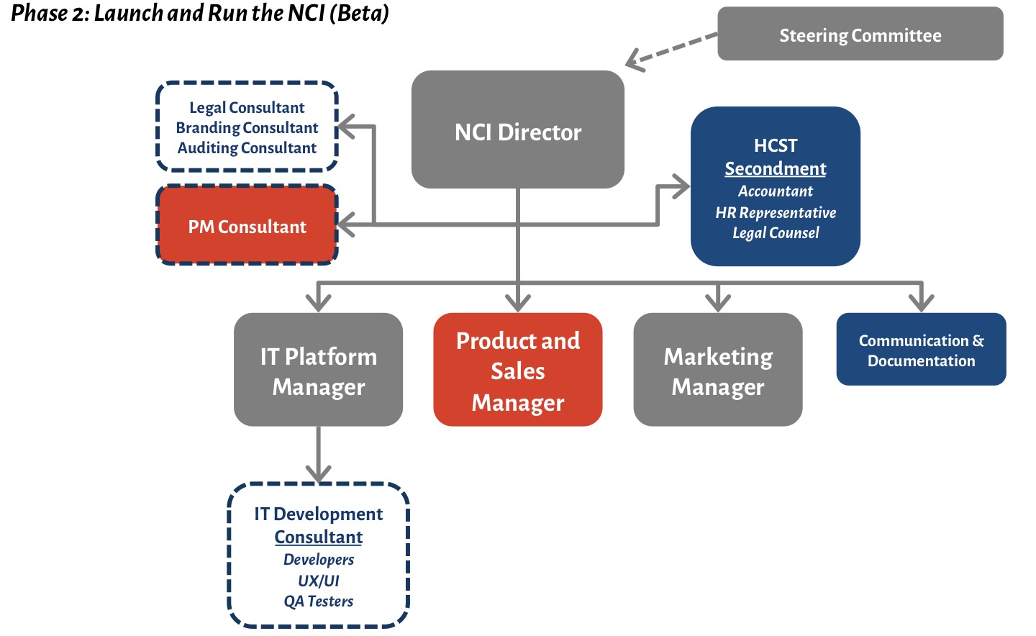
NCI Terms of Reference and Organizational Structure

Slide 28
NCI Steering Committee
Steering Committee mechanisms are important stakeholder management and advisory components for innovation agencies.
A Steering Committee is proposed to mobilize and activate the NCI’s strategy within the first two years of operations by linking up stakeholders, public and private, across the innovation value chain to optimize the NCI’s activities according to a shared vision.
It is important that the Steering Committee have a strong commitment to and ownership of the NCI’s vision, as well as an appreciation for the “political leadership” needed to break down barriers.

Slide 29
How the steering committee is expected to add value to the NCI
Ensuring adherence to the workplan and, critically, the attainment of the organizational objectives that will animate the NCI.
Revise and realign implementation priorities and priority action areas based on emerging resource availability and stakeholder cooperation.
Identify key barriers to implementation and measures to overcome them, particularly as pertains to mobilization of potential key platform users and marketing efforts.
Assess how existing policies, instruments, programs, and legal structures can enable and facilitate the NCI’s operation, and how to best situate the NCI from a legal perspective to pursue the activities envisioned here.
Monitor progress according to the metrics in the M&E Framework and strategize approaches to mitigating progress lags.

Slide 30
Thank you

